Slide 1
Topics covered
Agile methods
Plan-driven and agile development
Extreme programming
Agile project management
Scaling agile methods
Chapter 3 Agile software development

Slide 2
Rapid software development
Why?
  Need to react to changes more quickly than 2 year long waterfall projects
  2 years and then you got the design wrong anyway! Small deliveries aren't abstract
How?
  Goal - Deliver working software quickly
    Compromise - less functionality in a delivery, not lower quality
    Less documentation
  Focus on the code rather than the design
  Interleave
    Specification, design and implementation are inter-leaved
  Deliver small versions and get user (stakeholder) input
Chapter 3 Agile software development

Slide 3
Agile manifesto
Our values:
  Individuals and interactions over processes and tools
  Working software over comprehensive documentation
  Customer collaboration over contract negotiation
  Responding to change over following a plan
That is, while there is value in the items on the right, we value the items on the left more.
Chapter 3 Agile software development

Slide 4
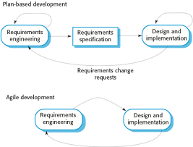
Plan-driven and agile specification
  separate development stages with the outputs to be produced at each of these stages planned in advance.
Iteration within stage
  Not necessarily waterfall model – plan-driven, incremental development is possible
User's full agreement at end, not before code
Iteration of stage
Chapter 3 Agile software development

Slide 5
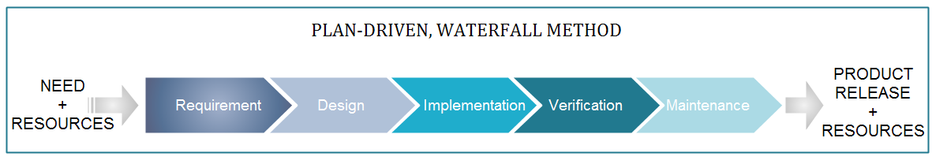
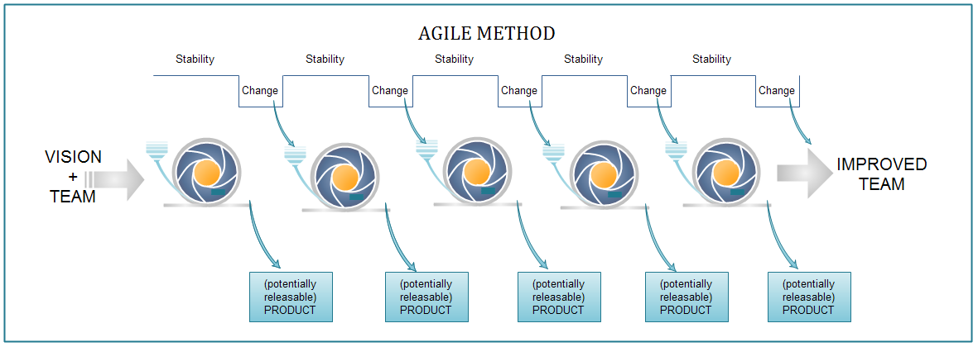
Copyright © 2010 AgileInnovation

Slide 6
Problems with agile methods
It can be difficult to keep the interest of customers / users who are involved in the process.
Team members may be unsuited to the intense involvement that characterizes agile methods.
Prioritizing changes can be difficult where there are multiple stakeholders.
Maintaining simplicity requires extra work.
Contracts may be a problem as with other approaches to iterative development.
Because of their focus on small, tightly-integrated teams, there are problems in scaling agile methods to large systems.
Less emphasis on documentation - harder to maintain when you get a new team for maintenance
Chapter 3 Agile software development

Slide 7
Balance plan driven and agile
Not great for Agile:
  What type of system is being developed?
    Plan-driven approaches may be required for systems that require a lot of analysis before implementation (e.g. real-time system with complex timing requirements).
  What is the expected system lifetime?
    Long-lifetime systems may require more design documentation to communicate the original intentions of the system developers to the support team.
  What technologies are available to support system development?
    Agile methods rely on good tools to keep track of an evolving design
  How is the development team organized?
    Many teams; Outsourcing ---> need design documents to control borders
  Culture or contract needs detailed specification
  Is rapid feedback from users realistic?
  Large scale, not co-located may require more formal communication methods
  Need high level programming skills - refactoring, work with little spec
  Outside regulation documentation requirements
Chapter 3 Agile software development

Slide 8
Extreme programming
A popular form of Agile
Extreme Programming (XP) takes an ‘extreme’ approach to iterative development.
  New versions may be built several times per day;
  Increments are delivered to customers every 2 weeks;
  All tests must be run for every build and the build is only accepted if tests run successfully.
Customer involvement means full-time customer engagement with the team. - Specifications through user stories broken into tasks
People not process : pair programming, collective ownership and a process that avoids long working hours.
Regular system releases. - release set of user stories
Maintaining simplicity through constant refactoring of code.
Chapter 3 Agile software development

Slide 9
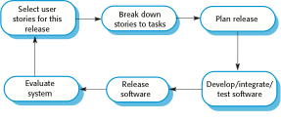
The extreme programming release cycle
Chapter 3 Agile software development

Slide 10

The Parts and the Whole
Iteration Plan
Daily Stand-Up
Controller
Set Target
Adapt
Inspect
Clean Design & Code & Refactor
User Stories - Late Elaboration
Shared Code Ownership
Test Driven Development…..
Pair Programming
Customer Reviews & Feedback
Retrospectives
AutoTest…..
Sustainable pace
Collective Ownership with users
Minimal documentation for sprint

Slide 11
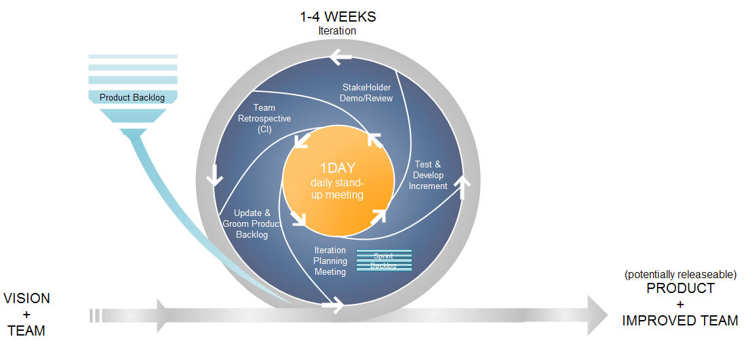
The Life of an Iteration
Copyright © 2010 AgileInnovation

Slide 12

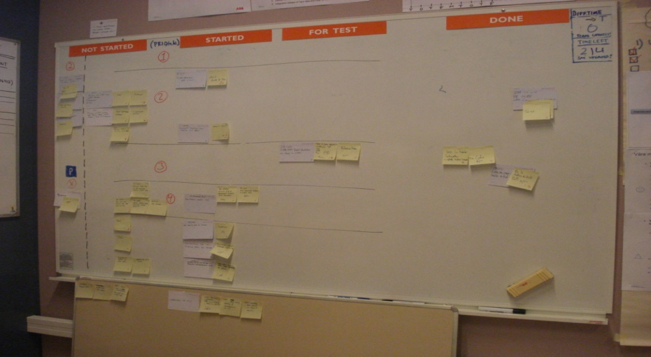
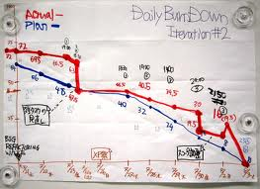
Transparency
“Tell me how you will measure me and I’ll tell you how I’ll behave”
Copyright © 2010 AgileInnovation

Slide 13
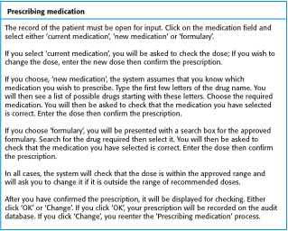
A ‘prescribing medication’ story
Chapter 3 Agile software development

Slide 14
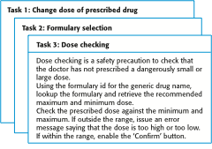
Examples of task cards for prescribing medication
Chapter 3 Agile software development

Slide 15
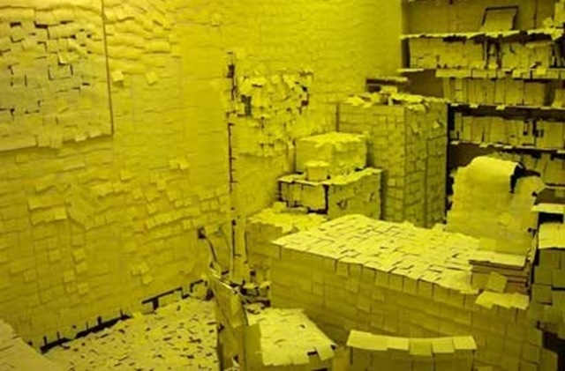

Slide 16
Refactoring
Programming team look for possible software improvements and make these improvements even where there is no immediate need for them.
This improves the understandability of the software and so reduces the need for documentation.
Changes are easier to make because the code is well-structured and clear.
However, some changes requires architecture refactoring and this is much more expensive.
RISK:
  Changes the user does not test
  Changes to working software break it
Chapter 3 Agile software development

Slide 17
Examples of refactoring
Re-organization of a class hierarchy to remove duplicate code.
Tidying up and renaming attributes and methods to make them easier to understand.
The replacement of inline code with calls to methods that have been included in a program library.
Chapter 3 Agile software development

Slide 18
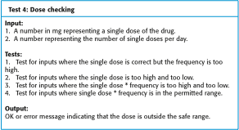
Test case description for dose checking
Chapter 3 Agile software development

Slide 19
Test automation
Automate tests (junit)
Run upon checkin
Difficulties:
  Time constraints
  Programmer preferences to not test
  Test coverage
Chapter 3 Agile software development

Slide 20
Pair programming
In XP, programmers work in pairs, sitting together to develop code.
Common ownership
Knowledge spread
Informal review
Refactoring
Similar output to two people coding
Chapter 3 Agile software development

Slide 21
Scrum
Project Manager's job: - Deliver needed system on time within budget
The Scrum approach - manage the iterations
There are three phases in Scrum.
  outline planning phase - general picture and architecture
  Sprint cycles releasing increments of the system.
  The project closure phase - final delivery, documentation and review of lessons learned.
Chapter 3 Agile software development

Slide 22
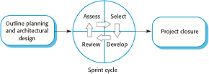
The Scrum process
Chapter 3 Agile software development

Slide 23
The Sprint cycle
Every 2–4 weeks (a fixed length).
1) Project team with customer: Look at product backlog - select stories to implement
2) implement with all customer communication through scrum master (protecting pgmr at this point)
  Scrum master has project manager role during sprint
  Daily 15 min meetings
    Stand up often
    Team presents progress and impediments
    Scrum master tasked with removing impediments
3) Review system release with user
Chapter 3 Agile software development

Slide 24
Scrum benefits
The product is broken down into a set of manageable and understandable chunks.
Unstable requirements do not hold up progress.
The whole team have visibility of everything and consequently team communication is improved.
Customers see on-time delivery of increments and gain feedback on how the product works.
Trust between customers and developers is established and a positive culture is created in which everyone expects the project to succeed.
Chapter 3 Agile software development

Slide 25
Summary
Plan Driven (Ex: Waterfall) vs Incremental (Ex: Agile )
  Structure and benefits and downfalls
XP - an implementation of Agile - Power to the Programmer
  User story requirements
  Test driven design with continual retest and integration
  Pair Programming
  Refactoring encouraged
Scrum - project management of Agile using sprints
  Iterations of full team contact / Scrum master protection of programmers / full team release review
Chapter 3 Agile software development

